Slide 1

Generative Adversarial Networks
Presented by Steven Kundert and Shenglin Sun

Slide 2
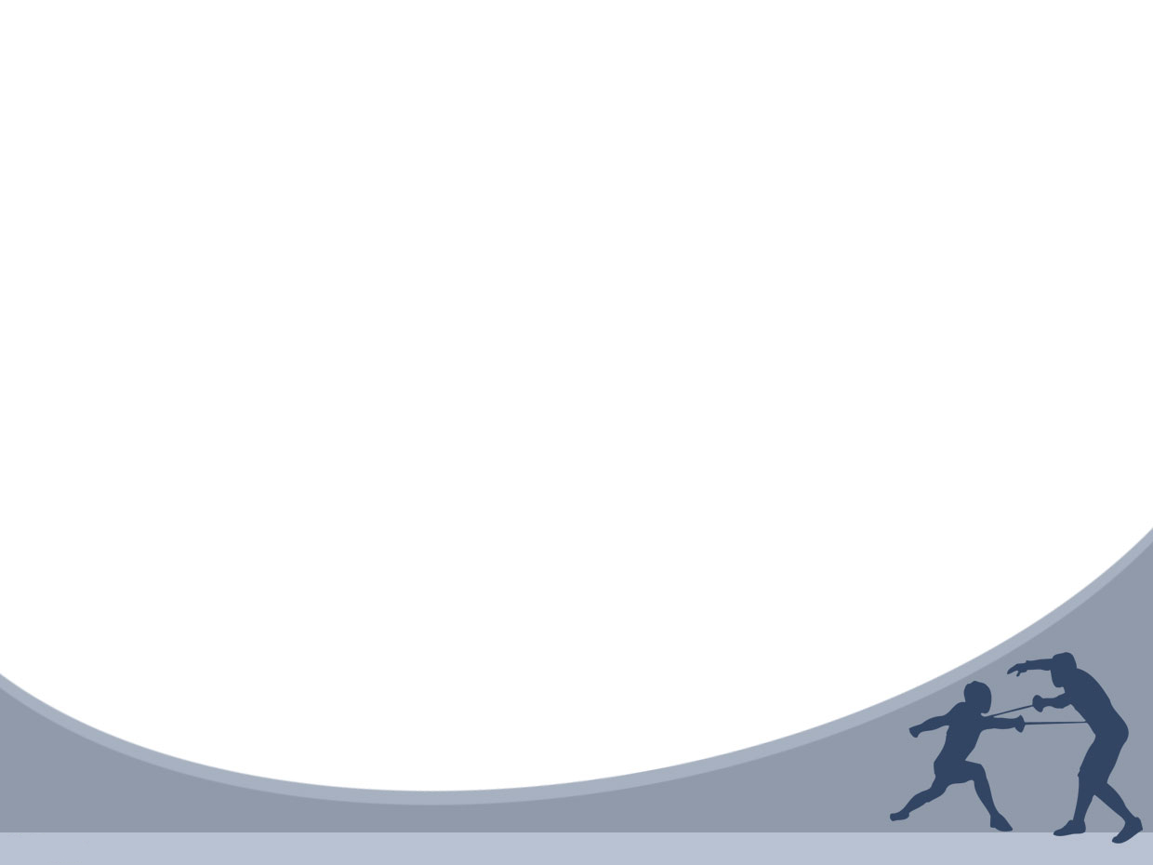
Outline
Introduction
Related Work
Adversarial Nets
Theoretical Results
Experiments
Advantages and Disadvantages
Conclusions and Future Work

Slide 3
Introduction
Deep learning has been used to model artificial intelligence
Most successful deep learning involves discriminative models that map input into class labels
Based on back-propagation and dropout algorithms using weight and bias vectors with well-behaved gradients

Slide 4
Introduction (cont’d)
Deep generative models have had less success
Difficult to leverage usefulness of weight and bias vectors
In an adversarial net, a generative model is pitted against an discriminative model that learns to tell whether a sample is real or fake

Slide 5
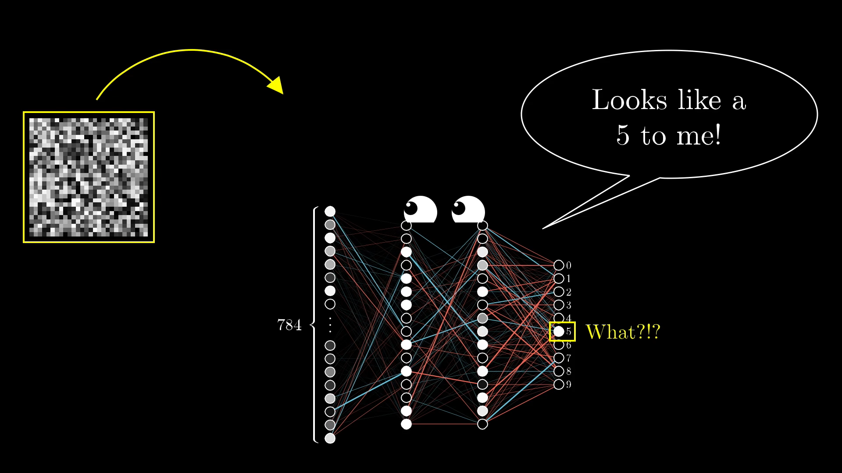
What happens when random data is input into the discriminative model?
The model thinks that the random data fits into the class ‘5’

Slide 6

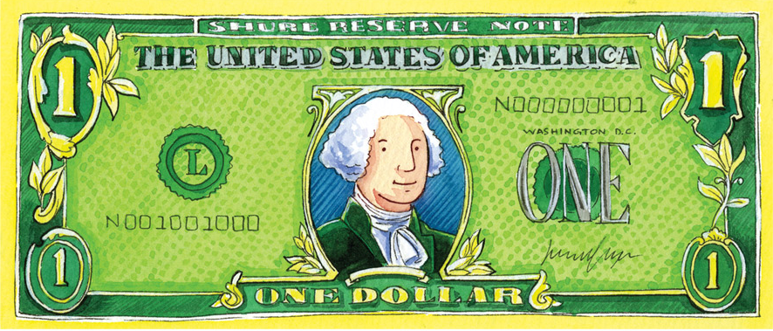
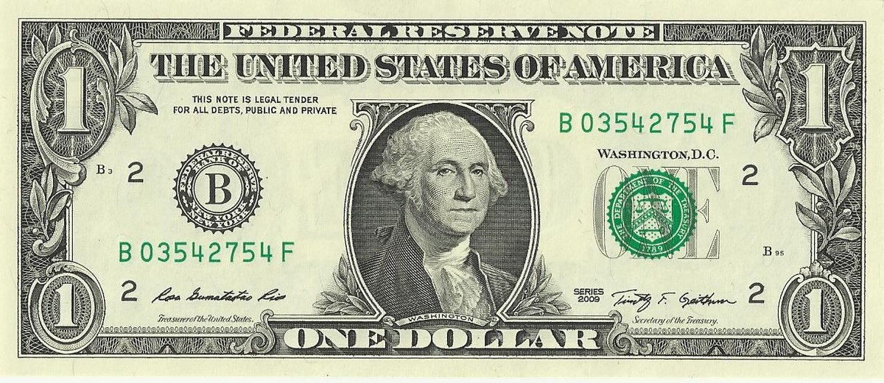

Example
Generative model acts like a currency counterfeiter
Discriminative model acts like police trying to catch counterfeits
Competition drives both to improve their methods until counterfeit is identical to real thing

Slide 7
Adversarial Nets

Slide 9
Theoretical Results

Slide 11
Experiment

Slide 13
Advantages and Disadvantages

Slide 15
Conclusions and Future Work

